Slide 1
Utilizing Data from an Incomplete Sample to Supplement the Probability Sample for U.S. PIAAC Cycle II
Wendy Van de Kerckhove, Tom Krenzke, Benjamin Schneider, and Mike Kwanisai
WESTAT @ JSM 2024 — Statistics and Data Science: Informing Policy and Countering Misinformation
The views presented are those of the author(s) and do not represent the views of any Government Agency/Department or Westat

Slide 2
Agenda
Background
Statistical problem/motivation
U.S. PIAAC Cycle II
Method for combining samples
Evaluation/outcomes
National estimates
Models
Summary and conclusion

Slide 3
Background

Slide 4
Statistical problem as motivation
Incomplete sample | Probability sample but with unexpected disruptions
Outcome of:
Probability selection,
Non-probabilistic mechanism that determined which sampled cases and areas (PSUs) were worked, and
Nonresponse
Use techniques for combining probability and non-probability samples
Notes:
Mention problem in larger context – e.g., disruptions due to COVID

Slide 5
U.S. PIAAC Cycle II | Overview
PIAAC = Program for the International Assessment of Adult Competencies
In-person survey of adult literacy, sponsored by the National Center for Education Statistics (NCES)
Part of international survey
Goal | High quality data and sufficient yield for:
National estimates,
Item Response Theory (IRT) models, and
Small-area estimates for state and county (by group)
Notes:
Explain IRT models

Slide 6
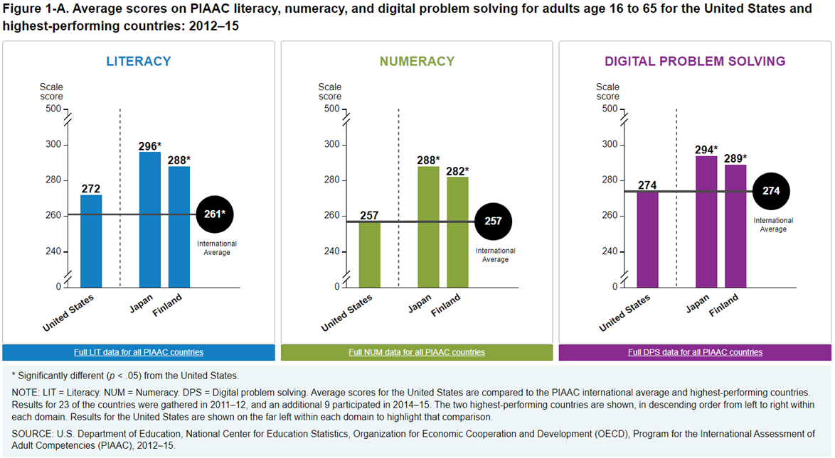
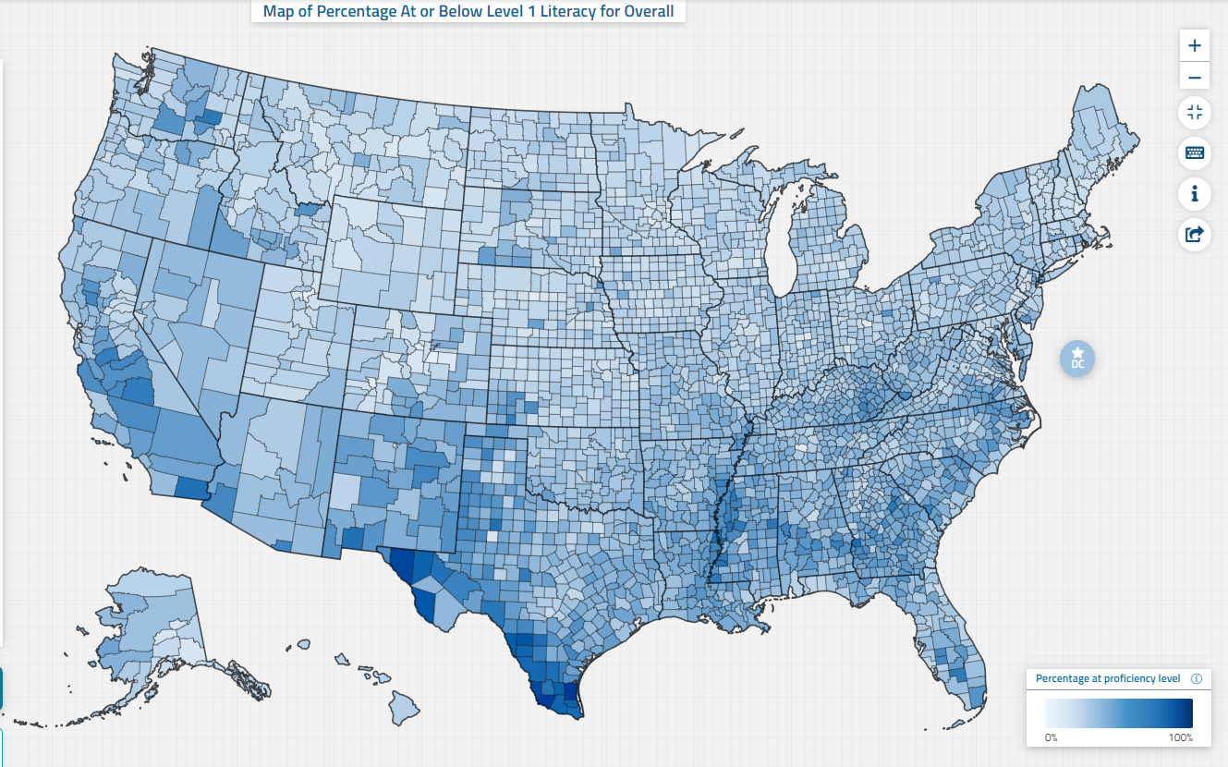
U.S. PIAAC Cycle II | Reporting
Examples from Cycle I
National estimates Overall, by domain, international comparisons
Model-based state and county-level estimates Overall and by domain
https://nces.ed.gov/surveys/piaac/measure.asp?section=2&sub_section=5
https://nces.ed.gov/surveys/piaac/skillsmap/

Slide 7
U.S. PIAAC Cycle II | Sample Design
4-stage area sample
Two components
Core sample – nationally representative
State supplemental sample – additional PSUs (counties/groups of counties) so that combined sample has at least 2 PSUs per state
See Van de Kerckhove et.al.(2022) JSM presentation
Data collection for state supplement halted mid-field-period
350 respondents (around 20% of target for supplemental sample)
Not evenly worked; work had not started in some PSUs
Core sample – 4,287 respondents
Notes:
Intentionally separated in case needed to stop supplement

Slide 8
Method for combining samples

Slide 9
Restrictions
Do not know the real probabilities due to stopped work
Need to produce weights (as opposed to estimates)
Do not have the outcome (proficiency scores) available at the time weighting
→ Model-based prediction (e.g., mass imputation) and doubly robust estimation are not applicable
Notes:
Do not know the real probabilities – including for the PSUs so couldn’t use PSU probabilities

Slide 10
Process
Calibration and compositing | Based on Dever (2018)
Core sample
Base weights
Nonresponse adjustments
Calibration
Composite
Raking and trimming
Combined sample
Supplemental respondents
Weight of 1
Calibration

Slide 11
Initial Weights for Supplemental Sample
Base weight of 1 with one-step calibration
Considered alternative approaches, but...
Small non-probability sample combined with large probability sample
Bias less a concern than with large non-probability samples
Placed emphasis on limiting variance
If... | Then...
Inclusion in the supplemental sample is independent of key survey outcomes after conditioning on the calibration variables | Enables unbiased estimation
Notes:
Limiting variance due to unequal weights
“calibration variables” -- Including the calibration at the end

Slide 12
Pre-compositing calibration
Post-stratified both samples to ACS population totals for age group by region by education
Age | To distinguish international target population vs U.S.-only
Region | Related to proportion of supplemental cases that were worked
Education | Related to proficiency
Excluded certainty PSUs
Cell | Age group | Region | Education level
1 | 16-65 | 1 | -
2 | 16-65 | 2 | -
3 | 16-65 | 3 | Non-college graduates
4 | 16-65 | 3 | College graduates
5 | 16-65 | 4 | Non-college graduates
6 | 16-65 | 4 | College graduates
7 | 66-74 | - | Non-college graduates
8 | 66-74 | - | College graduates
Notes:
Decided not to rake by major strata because the control totals need to be derived at state level. PUMAs can cross stratum boundaries.

Slide 13
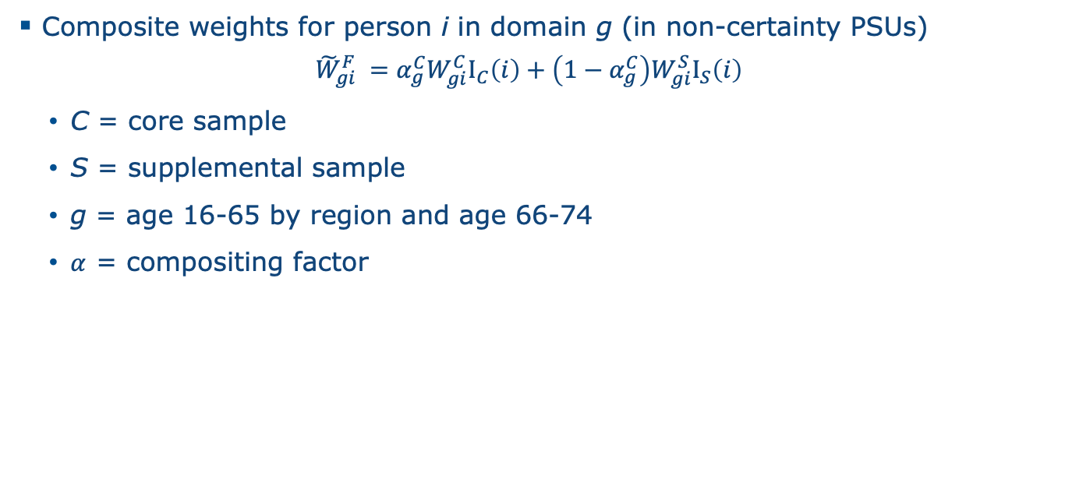
Compositing (1)
Composite weights for person i in domain g (in non-certainty PSUs)
$${\tilde{W}}_{gi}^{F} =α_{g}^{C}W_{gi}^{C}I_{C}\left(i\right)+\left(1−α_{g}^{C}\right)W_{gi}^{S}I_{S}\left(i\right)$$
C = core sample
S = supplemental sample
g = age 16-65 by region and age 66-74
$α$ = compositing factor

Slide 14
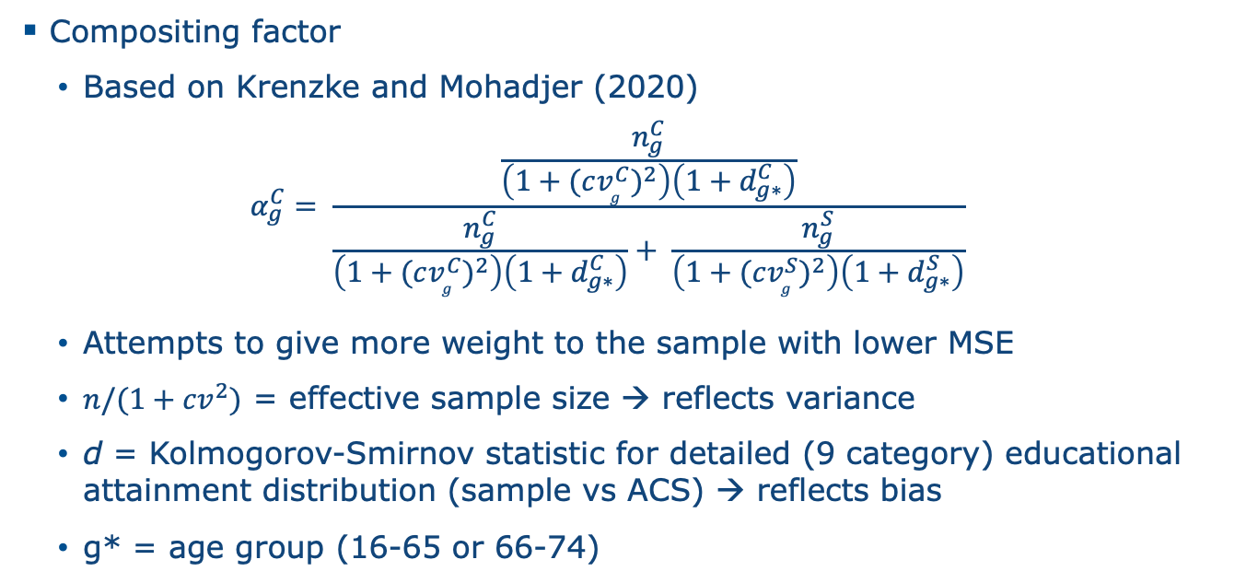
Compositing (2)
Compositing factor
Based on Krenzke and Mohadjer (2020)
$$α_{g}^{C}= \frac{\frac{n_{g}^{C}}{\left(1+{(cv_{g}^{C})}^{2}\right)\left(1+d_{g∗}^{C}\right)}}{\frac{n_{g}^{C}}{\left(1+{(cv_{g}^{C})}^{2}\right)\left(1+d_{g∗}^{C}\right)}+ \frac{n_{g}^{S}}{\left(1+{(cv_{g}^{S})}^{2}\right)\left(1+d_{g∗}^{S}\right)}}$$
Attempts to give more weight to the sample with lower MSE
$n/(1+{cv}^{2})$ = effective sample size → reflects variance
d = Kolmogorov-Smirnov statistic for detailed (9 category) educational attainment distribution (sample vs ACS) → reflects bias
g* = age group (16-65 or 66-74)

Slide 15
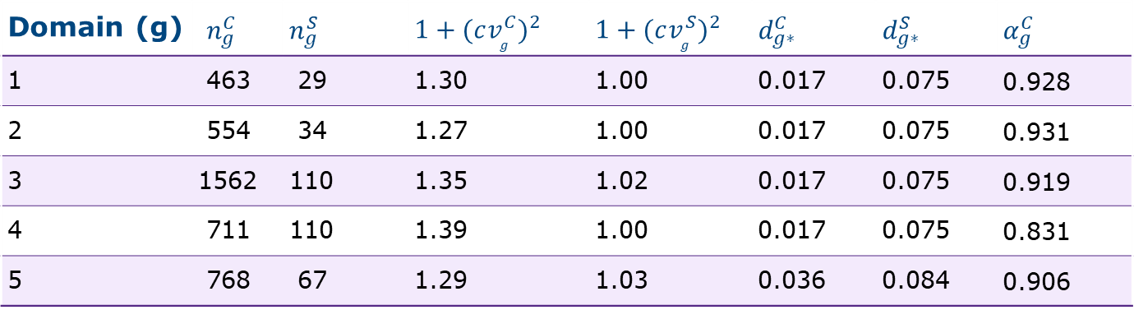
Compositing (3)
Domain (g) | $$n_{g}^{C}$$ | $$n_{g}^{S}$$ | $$1+{(cv_{g}^{C})}^{2}$$ | $$1+{(cv_{g}^{S})}^{2}$$ | $$d_{g∗}^{C}$$ | $$d_{g∗}^{S}$$ | $$α_{g}^{C}$$
1 | 463 | 29 | 1.30 | 1.00 | 0.017 | 0.075 | 0.928
2 | 554 | 34 | 1.27 | 1.00 | 0.017 | 0.075 | 0.931
3 | 1562 | 110 | 1.35 | 1.02 | 0.017 | 0.075 | 0.919
4 | 711 | 110 | 1.39 | 1.00 | 0.017 | 0.075 | 0.831
5 | 768 | 67 | 1.29 | 1.03 | 0.036 | 0.084 | 0.906

Slide 16
Variance Estimation
Replication required by PIAAC data tools
Core sample | 44 replicates using BRR with Fay’s adjustment
Supplemental sample
Created 14 variance strata/units
Based on original sample design
Additional collapsing for small or empty PSUs
Created 44 replicates using BRR with Fay’s adjustment
Combined sample | 44 replicates

Slide 17
Evaluation/outcomes

Slide 18
National estimates | Evaluation (1)
Evaluation was required to determine if the supplemental sample could be included in national and international reports
Produced weights for core-only sample and compared results against composite sample in terms of:
Weights
Estimates
Variances
Associations

Slide 19
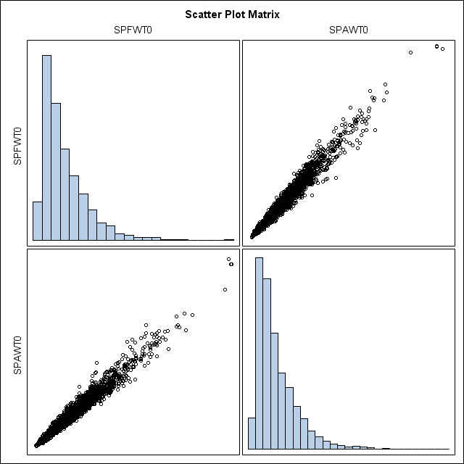
National estimates | Evaluation (2)
Weights | correlation of 0.989
SPAWT0 = core-only weight; SPFWT0 = combined sample weight

Slide 20
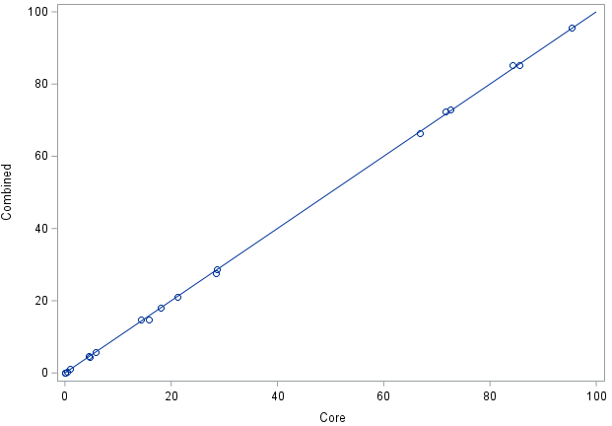
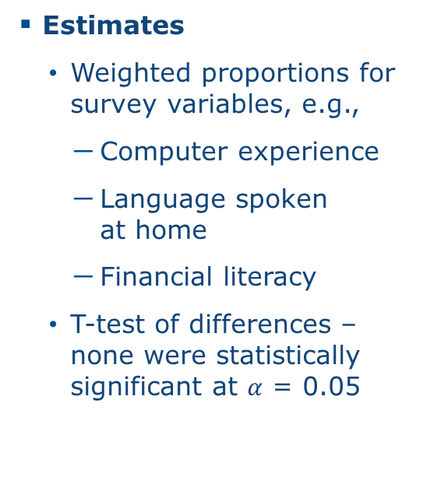
National estimates | Evaluation (3)
Estimates
Weighted proportions for survey variables, e.g.,
Computer experience
Language spoken at home
Financial literacy
T-test of differences – none were statistically significant at $α$ = 0.05
Survey variable estimates for Core vs. Combined

Slide 21
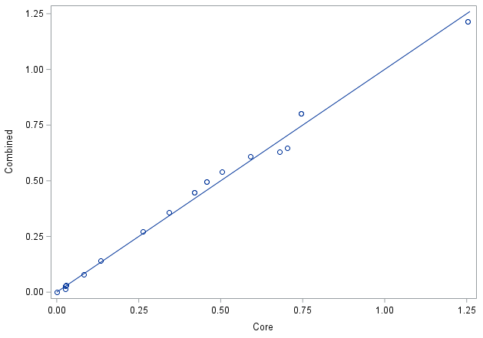
National estimates | Evaluation (4)
Variances
CVs of final weights - 69% for Core vs. 68% for Combined
Compared variances for auxiliary variable estimates
No statistical test
Similar in magnitude
Variance estimates for Core vs Combined
Notes:
Might be SE not variance

Slide 22
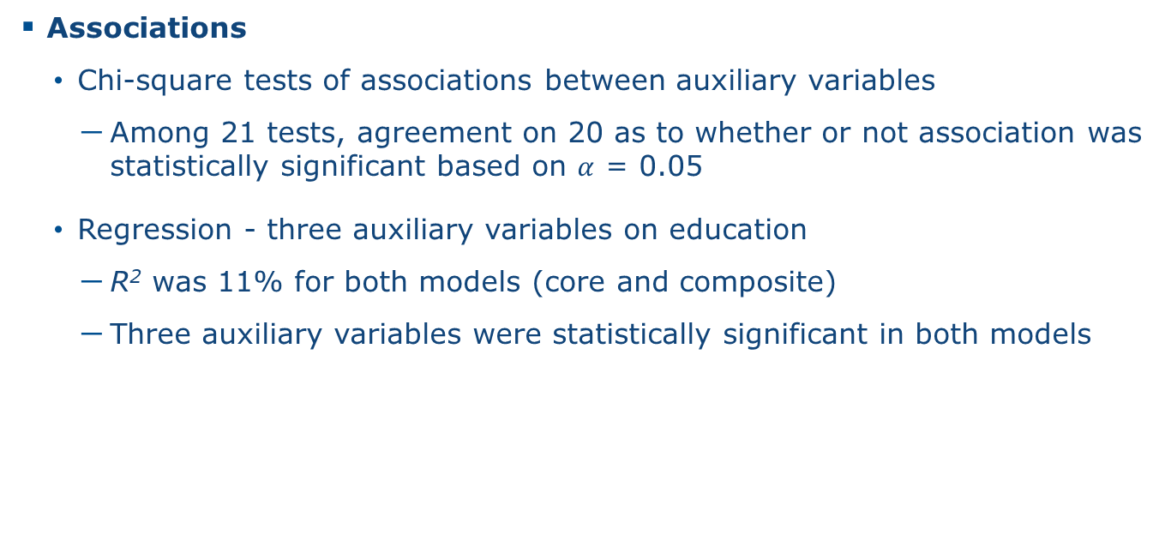
National estimates | Evaluation (5)
Associations
Chi-square tests of associations between auxiliary variables
Among 21 tests, agreement on 20 as to whether or not association was statistically significant based on $α$ = 0.05
Regression - three auxiliary variables on education
R² was 11% for both models (core and composite)
Three auxiliary variables were statistically significant in both models

Slide 23
Models
IRT model | combined sample met minimum sample size requirements
SAE | supplemental sample increased number of states and counties with data
→ Less reliance on the model
Count | Core | Combined
States with data | 34 | 48
Counties with data | 89 | 126
States with 2 or more PSUs | 31 | 37
Notes:
2 or more PSUs – for variance and also b/c a lot of variation within state

Slide 24
Summary and conclusion

Slide 25
Summary and conclusion
Challenge | Incomplete supplemental sample
Method | Calibration and compositing
Conclusion | Including the incomplete supplemental sample in PIAAC
Has a negligible effect on national estimates
Strengthens model-based estimates

Slide 26
Thank you
WendyVandeKerckhove@westat.com
westat.com

